Slide 1
The Battle of Neighborhoods | Finding a Better Place in Scarborough, Toronto Final Report for Capstone Project
by Dr. Pankaj Agarwal

Slide 2
Introduction
The purpose of this Project is to help people in exploring better facilities around their neighborhood. It will help people making smart and efficient decision on selecting great neighborhood out of numbers of other neighborhoods in Scarborough, Toranto.
Lots of people are migrating to various states of Canada and needed lots of research for good housing prices and reputated schools for their children. This project is for those people who are looking for better neighborhoods. For ease of accessing to Cafe, School, Super market, medical shops, grocery shops, mall, theatre, hospital, like minded people, etc.
This Project aim to create an analysis of features for a people migrating to Scarborough to search a best neighborhood as a comparative analysis between neighborhoods.
It will help people to get awareness of the area and neighborhood before moving to a new city, state, country or place for their work or to start a new fresh life.

Slide 3
Data Extraction & Cleaning
we have used Scarborough dataset which was scrapped from wikipedia. Dataset consisting of latitude and longitude, zip codes.
we extracted the attributes 'Postalcode','Borough' and 'NeighborhoodDataset. It was then then cleaned.
postal code for Toronto, Ontario was then extracted

Slide 4
Foursquare API Data:
In order to gain that information we will use "Foursquare" locational information. Foursquare is a location data provider with information about all manner of venues and events within an area of interest.
For each neighborhood, we have chosen the radius to be 100 meter.
The data retrieved from Foursquare contained information of venues within a specified distance of the longitude and latitude of the postcodes.
The information obtained per venue as follows:
Neighborhood
Neighborhood Latitude
Neighborhood Longitude
Venue
Name of the venue e.g. the name of a store or restaurant
Venue Latitude
Venue Longitude
Venue Category

Slide 5
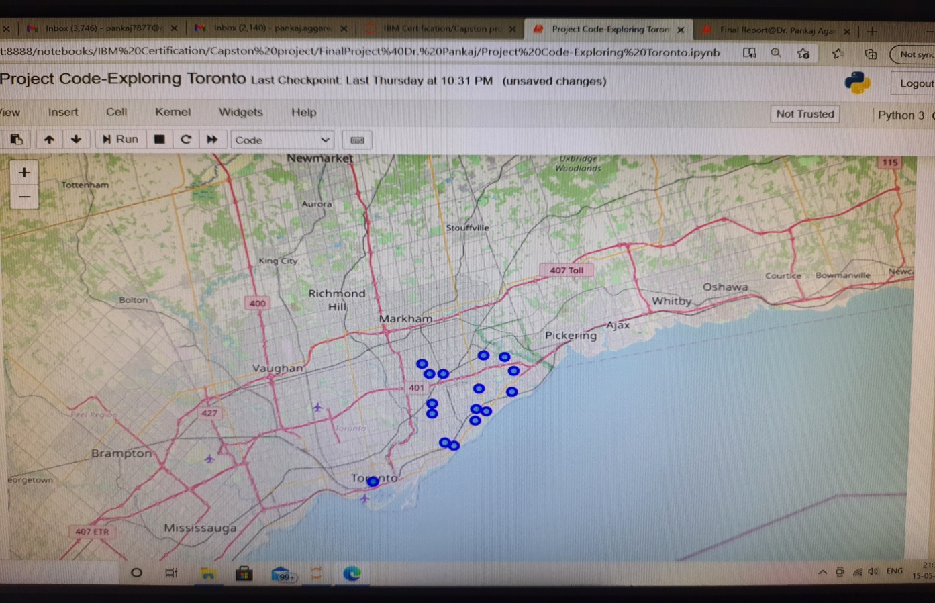
Map of Scarborough
Geograpical Co-ordinate of Neighborhoods w.r.t address Scarborough,Toronto were determined. we then fetched the nearby locations in tabular form followed by categories fetching. Some of the fetched categories include Clothing Store,Restaurant,Coffee Shop,Intersection,Sandwich Place,Gas Station,,department Store etc. our project fetchd 107 categories.

Slide 6
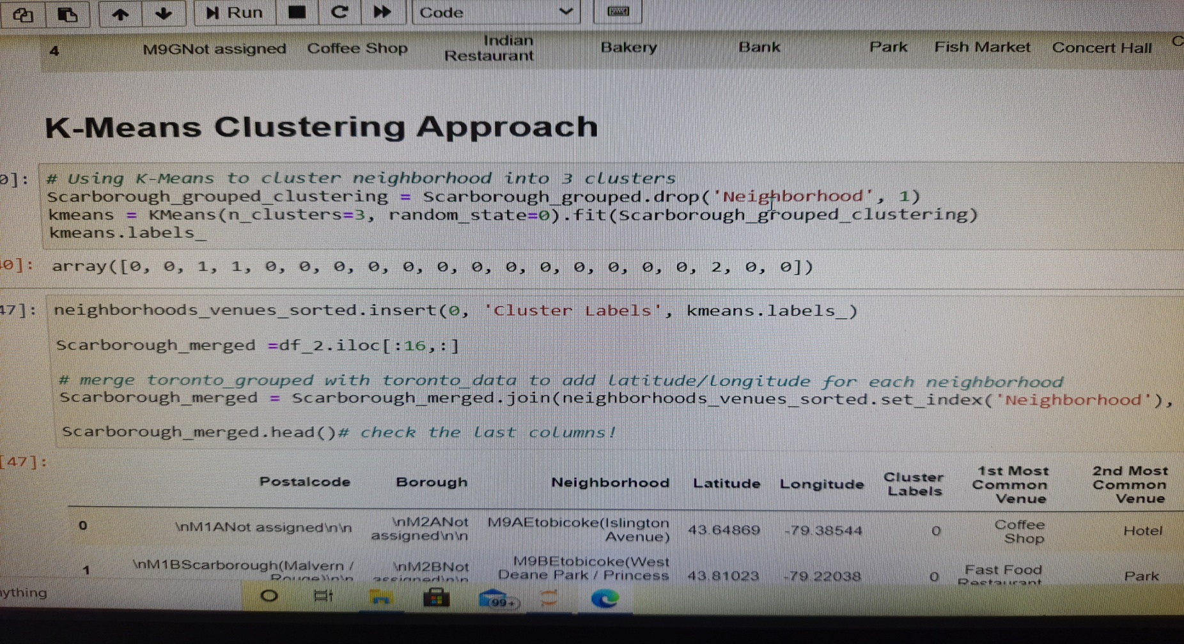
Clustering
To compare the similarities of two cities, we decided to explore neighborhoods, segment them, and group them into clusters to find similar neighborhoods in a big city like New York and Toronto. To be able to do that, we need to cluster data which is a form of unsupervised machine learning: k-means clustering algorithm.

Slide 7
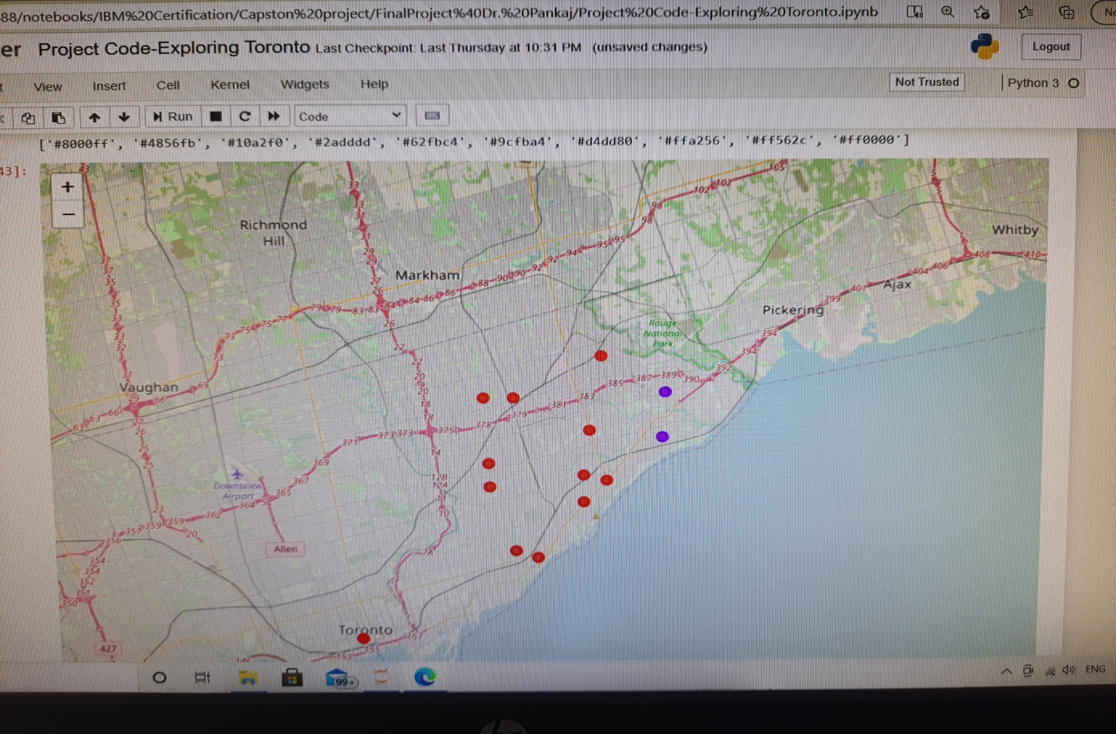
Results
we used folium library of python to determine the map of clusters with k-clusters value of 10

Slide 8
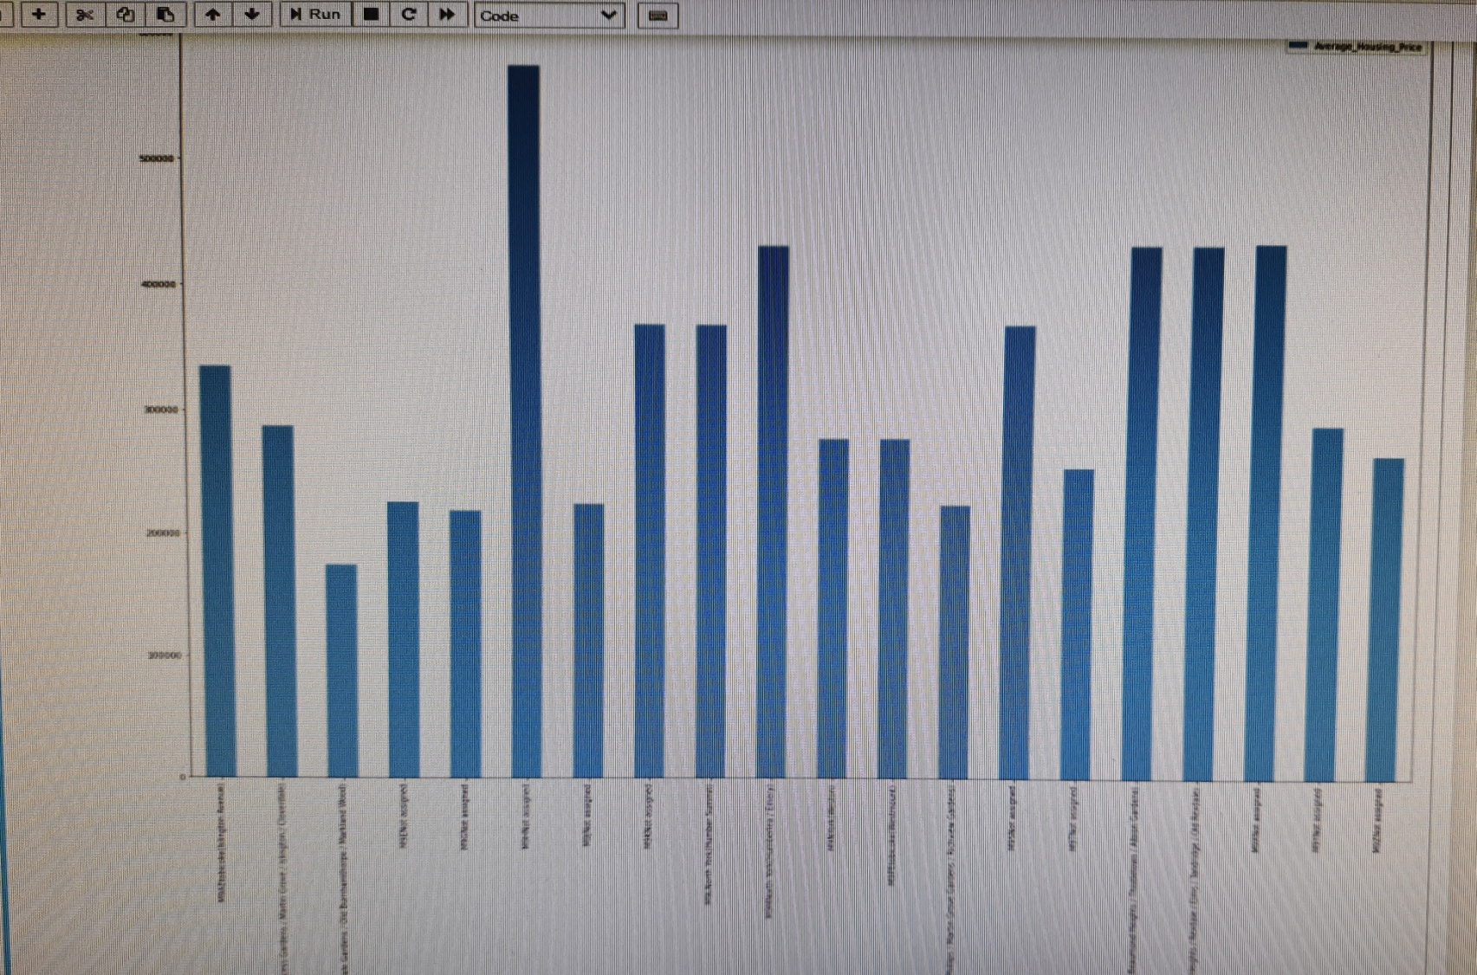
Average Housing Price by Clusters in Scarborough
we obtained following average housing price for Scarborough

Slide 9
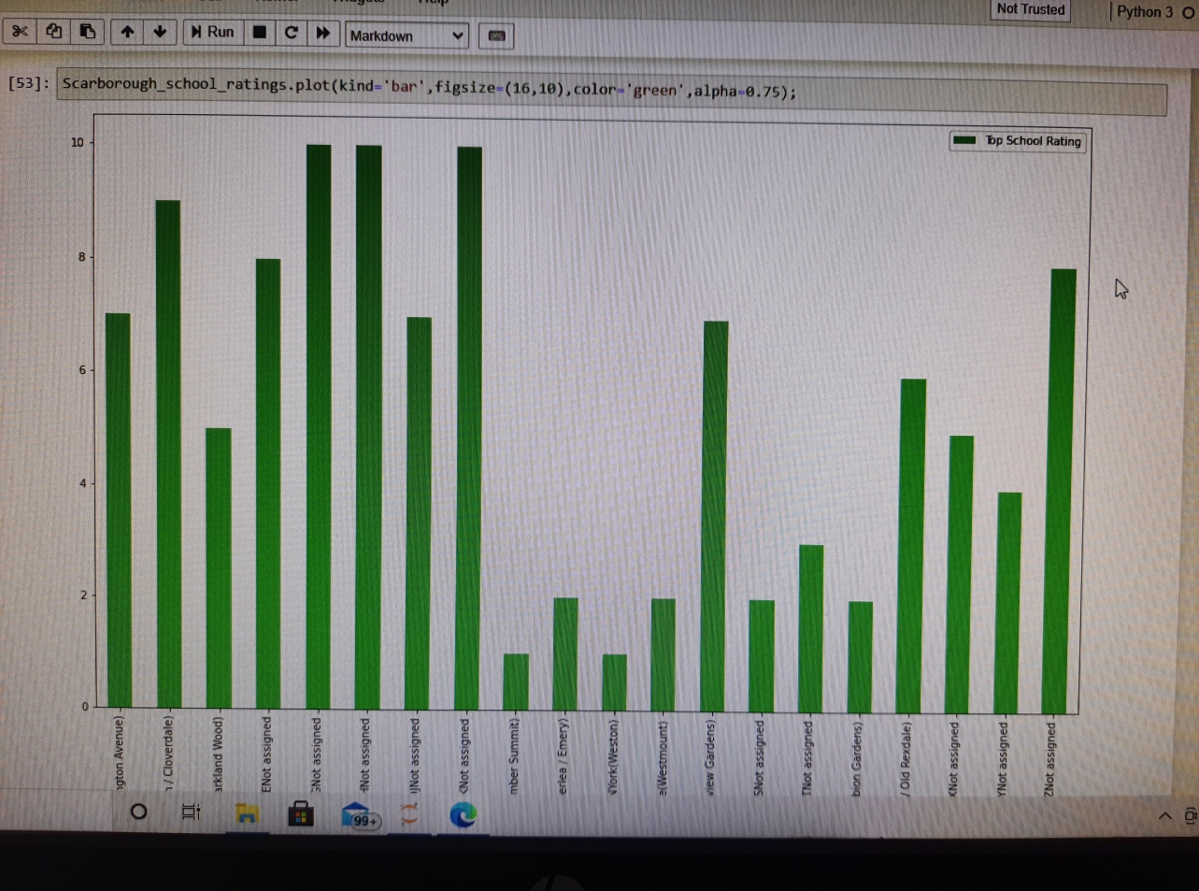
School Ratings by Clusters in Scarborough
Scarborough is a popular destination for new immigrants in Canada to reside. As a result, it is one of the most diverse and multicultural areas in the Greater Toronto Area, being home to various religious groups and places of worship. Although immigration has become a hot topic over the past few years with more governments seeking more restrictions on immigrants and refugees, the general trend of immigration into Canada has been one of on the rise.

Slide 10
Conclusion
The major purpose of this project, is to suggest a better neighborhood in a new city for the person who are shiffting there. Social presence in society in terms of like minded people. Connectivity to the airport, bus stand, city center, markets and other daily needs things nearby.
Sorted list of house in terms of housing prices in a ascending or descending order
Sorted list of schools in terms of location, fees, rating and reviews
In this project, using k-means cluster algorithm we were able to separate the neighborhood into 10(Ten) different clusters and for 103 different lattitude and logitude from dataset, which have very-similar neighborhoods around them. Using the charts above results presented to a particular neighborhood based on average house prices and school rating have been made.

Slide 11
Future Works:
This project can be continued for making it more precise in terms to find best house in Scarborough. Best means on the basis of all required things(daily needs or things we need to live a better life) around and also in terms of cost effective.

